Slide 1

AI in Market Trend Analysis
Stock Market Prediction

Slide 2




Project Abstract
This project introduces an AI-powered system for stock market prediction. It leverages a Flask backend with an LSTM model for price prediction and a React + TypeScript frontend for an intuitive user experience.
AI Prediction
Interactive Frontend
LSTM model for next-day stock price forecasting.
React UI with search, autocomplete, and dashboards.
Global Markets
Supports US, India, China, Japan, and UK stocks.

Slide 3

Introduction & Objectives
Why AI in Stock Analysis?
AI offers powerful tools to analyze vast financial data, identify patterns, and make informed predictions, crucial in volatile markets.
Project Goals:
Predict stock prices with AI.
Provide intuitive market insights.
Support global stock markets.
Streamline trend analysis.

Slide 4

Background: AI in Finance
Artificial Intelligence and Machine Learning are transforming financial markets. Our project utilizes key techniques:
LSTM Networks
Long Short-Term Memory (LSTM) models excel at processing sequential data, making them ideal for time-series predictions like stock prices.
Trend Analysis
AI algorithms identify underlying trends and patterns in historical stock data, providing a basis for future forecasts.

Slide 5





System Architecture
Frontend (React)
User interface built with React and TypeScript, styled with TailwindCSS, and charts via Recharts.
Backend (Flask)
Python Flask application serving API endpoints and hosting the trained LSTM model.
Data Source
Yahoo Finance API for real-time and historical stock data retrieval.
LSTM Model
Trained on historical stock price data for next-day predictions.

Slide 6

Methodology
01
Data Collection & Preprocessing
Gathering historical stock data from Yahoo Finance API, cleaning, and normalizing for model input.
02
Model Training
Training the LSTM model on prepared data to learn complex patterns and predict future prices.
03
Flask API Development
Building robust API endpoints for stock search, data retrieval, and prediction requests.
04
React UI Implementation
Developing interactive components for search, autocomplete, and dynamic dashboard visualizations.

Slide 7
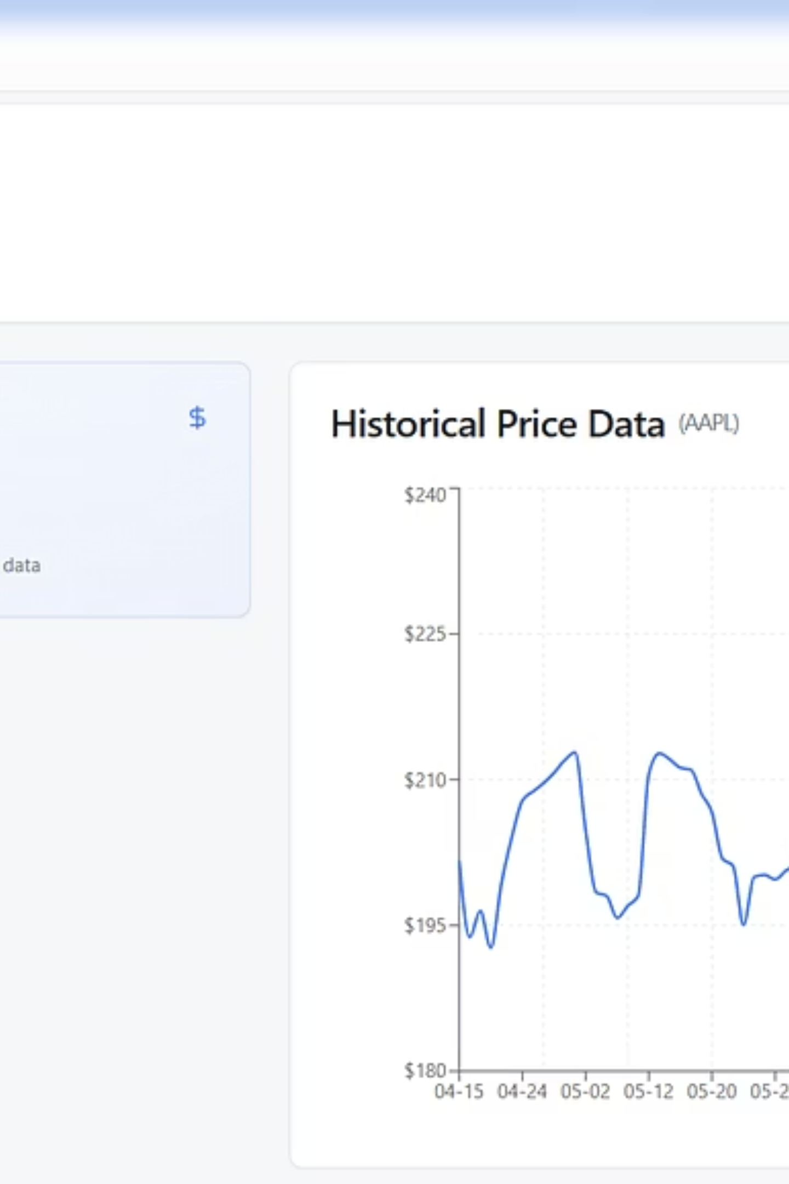
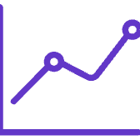



Key Features
Next-Day Price Prediction
AI-driven forecasts for future stock values.
Company/Ticker Search
Effortless lookup by name or ticker symbol with autocomplete.
Interactive Dashboard
Visualizes predicted prices, 100-day historical charts, and trend analysis.
Recent Searches
Locally stored search history for quick access.

Slide 8

Applications
Our system provides valuable insights for various stakeholders in the financial world:
Individual Investors
Financial Institutions
Global Market Analysts
Empowering personal investment decisions with data-driven predictions.
Supporting strategic analysis and risk assessment for portfolios.
Facilitating cross-market comparisons and trend identification across major exchanges.

Slide 9
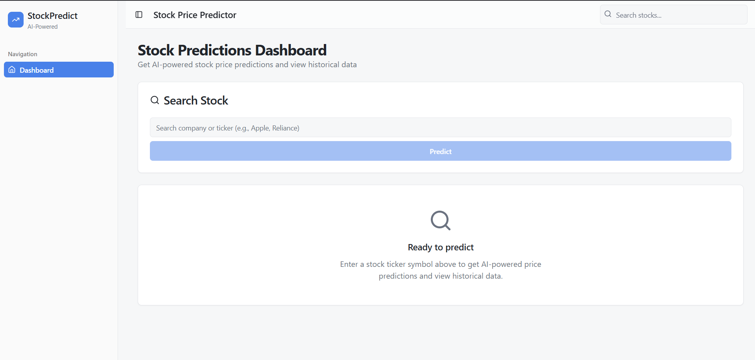
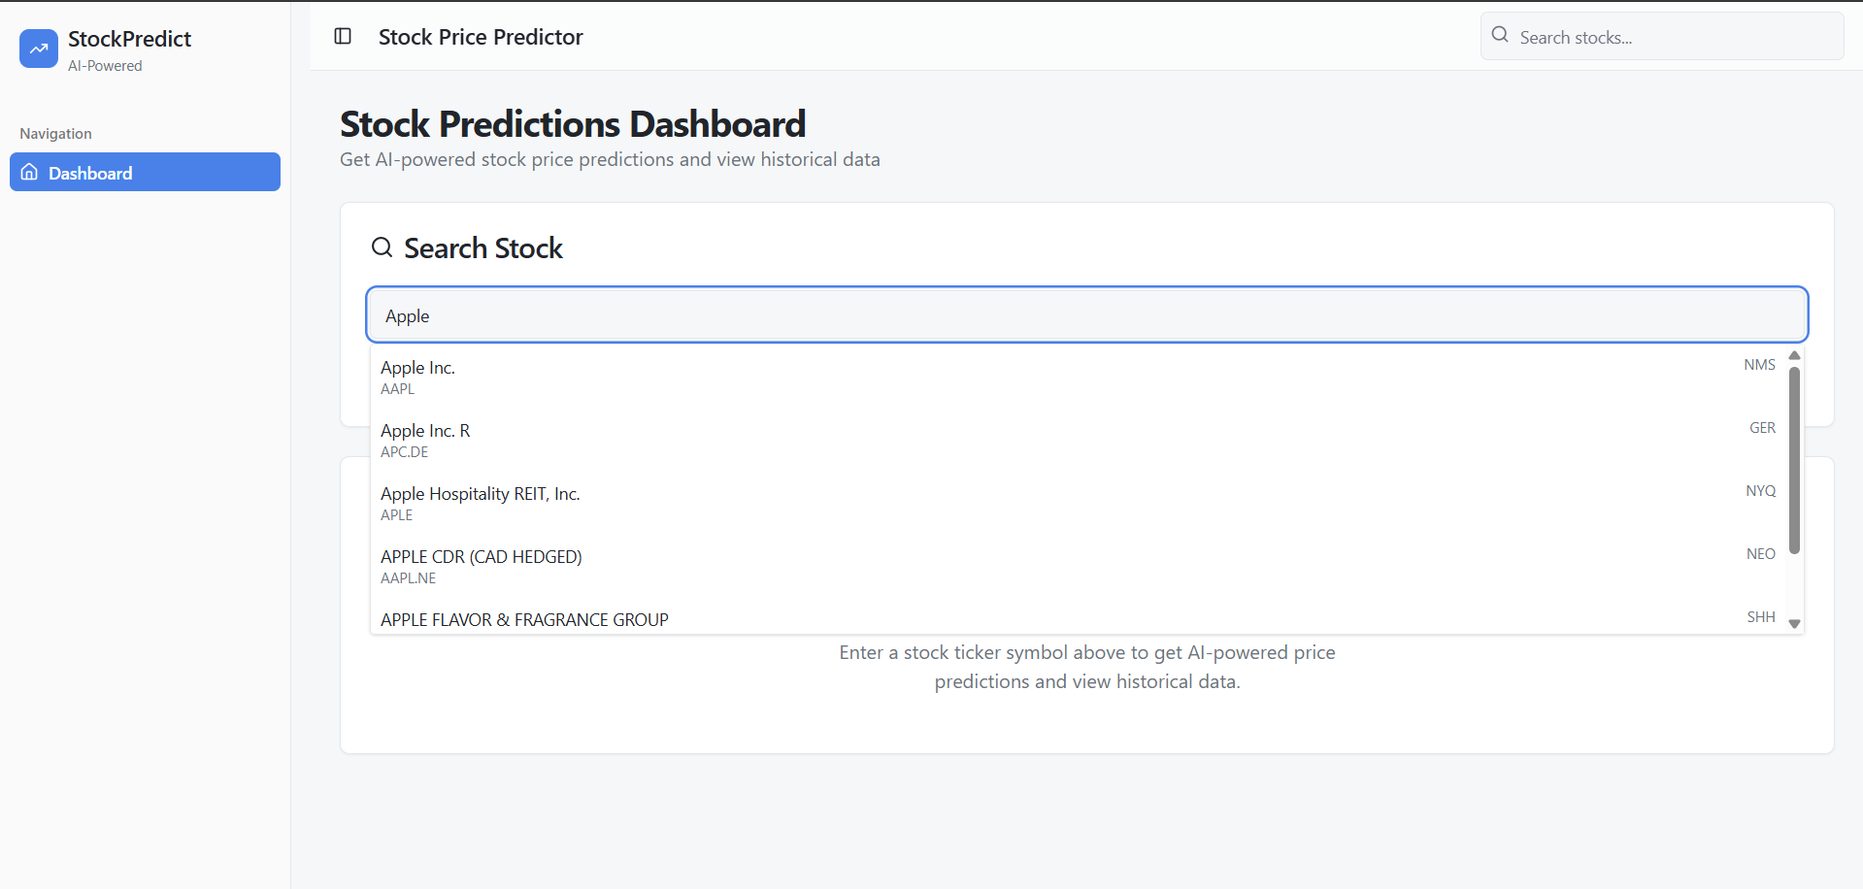
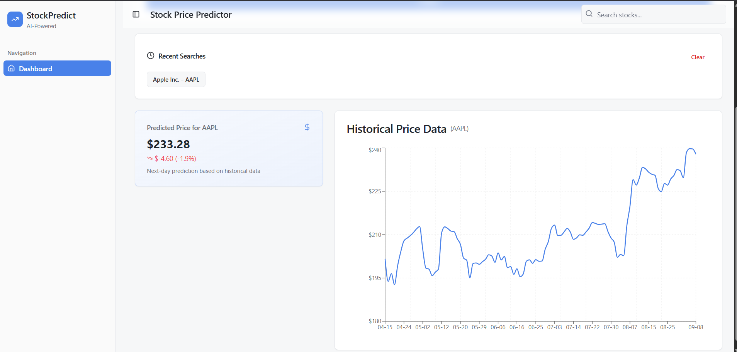
Demo Screen Snaps

Slide 10

Project Limitations
While powerful, our current model has specific limitations:
1-Day Predictions
No Sentiment/News Data
Currently, the model is optimized for predicting only the next day's stock price.
The model relies solely on historical price data, excluding external factors like news or social sentiment.

Slide 11

Future Enhancements & Conclusion
Future Enhancements:
Conclusion:
Multi-Currency Support: Integrate currency conversion for diverse global trading.
Sentiment Analysis: Incorporate news and social media sentiment for richer predictions.
Transformer Models: Explore advanced AI architectures for improved accuracy.
Our "AI in Market Trend Analysis" project successfully demonstrates the power of AI in stock
price prediction and market trend analysis. It provides a robust foundation for future development
in financial technology.

